Slide 1


Visual Storytelling with DALL.E AI: A Guide for K-12 Educators
ETT 530: User-Centered Design of Instructional Materials
2/16/25 by Faith Jebet Bitok
Notes:
Tech-savvy educators: Those who are comfortable using technology in the classroom.
Tech-novice educators: Those who may feel intimidated by new tools like DALL·E.
Subject-specific educators: Teachers of art, history, science, etc., who might use DALL·E differently.

Slide 2


Section 1
Section 1
Understanding DALL-E AI and Its Capabilities

Slide 3

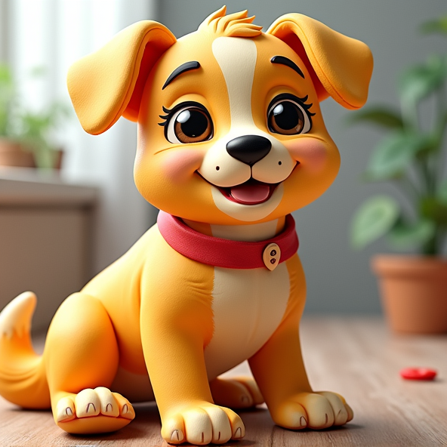
What It Is and How It Works
DALL-E AI Overview
DALL-E AI is a cutting-edge generative model that transforms textual descriptions into high-quality images, enhancing creative expression and visual storytelling in K-12 education through interactive and iterative design processes.

Slide 4



Text-to-Image Generation
01
02
03
Innovative Learning Tool
Enhancing Student Interaction
Diverse Learning Support
DALL-E AI empowers educators to create customized visual content, enhancing engagement and understanding of complex subjects through tailored imagery that resonates with students.
By allowing students to visualize their ideas, DALL-E fosters active participation and collaboration, encouraging them to express their thoughts creatively and critically.
The technology accommodates various learning styles, particularly benefiting visual learners and ELLs by providing clear, illustrative representations of abstract concepts.

Slide 5




Enhancing Visual Learning
Transformative Learning Experience
DALL-E AI enhances visual learning by creating tailored images that clarify complex concepts, making lessons more engaging and accessible for diverse learners.
Interactive Engagement
The use of DALL-E AI fosters an interactive classroom environment, encouraging students to visualize and articulate their ideas, thus promoting deeper understanding and collaboration.
Support for Diverse Needs
By providing visual representations, DALL-E AI caters to various learning styles, particularly benefiting visual learners and those with language barriers, enhancing overall educational outcomes.

Slide 6


Navigating Challenges in Image Generation
01
02
Limitations of AI Models
Ethical and Technical Considerations
Educators must recognize that DALL-E may struggle with generating images that include text or complex concepts, necessitating careful prompt crafting to achieve desired outcomes.
Addressing biases in AI-generated images and ensuring equitable access to technology are crucial for educators to effectively integrate DALL-E into diverse learning environments.

Slide 7
Section 2
Section 2
Integrating DALL-E AI into K-12 Education

Slide 8
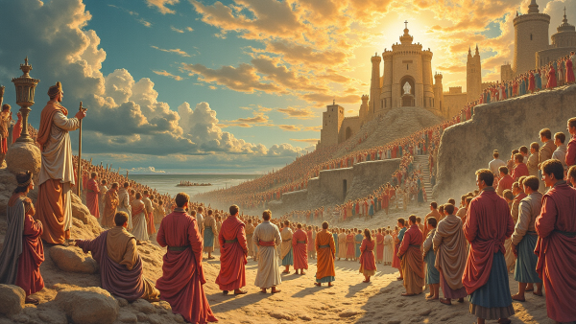

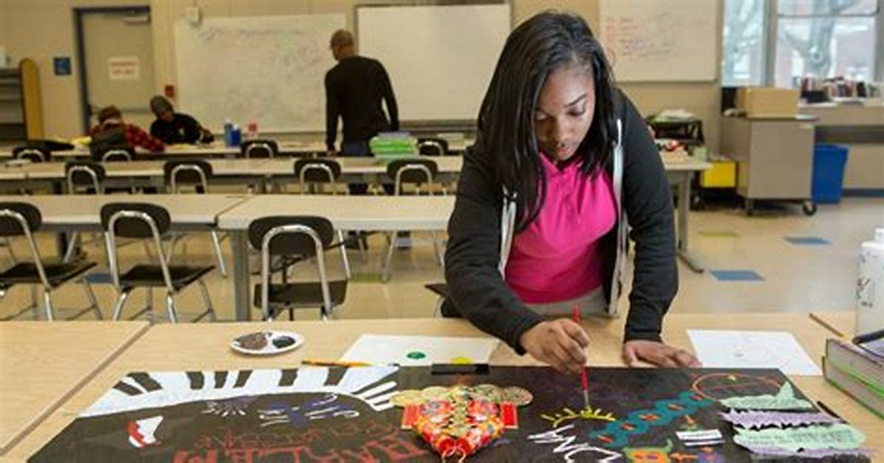
Examples and Best Practices
Visual Narrative Creation
Cross-Disciplinary Projects
Engagement through Art
Utilize DALL-E AI to generate images that illustrate key scenes from literature, enhancing comprehension and discussion about characters, themes, and settings in the classroom.
Design collaborative projects that integrate multiple subjects, allowing students to synthesize knowledge and creativity by visualizing concepts like sustainable city designs using DALL-E AI.
Encourage students to create visual representations of abstract concepts in subjects like environmental science, fostering deeper engagement and critical thinking about sustainability and conservation.

Slide 9
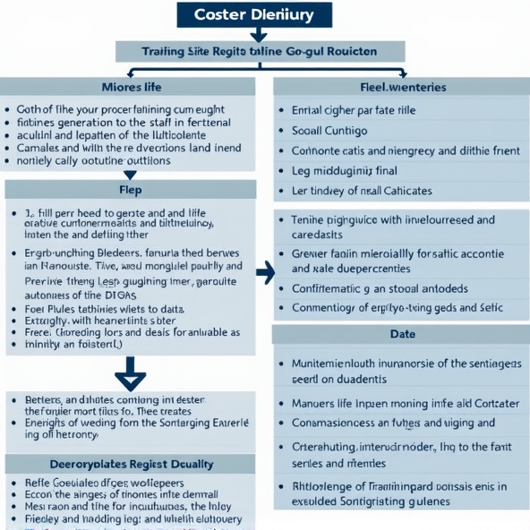
Case Studies
DALL-E in Language Arts
Implementing DALL-E in a third-grade classroom enhanced literacy skills among ELLs by allowing students to visualize their narratives, resulting in improved descriptive writing, increased motivation, and collaborative learning through image feedback.

Slide 10
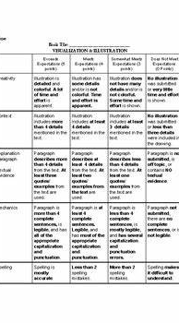
Student Projects Using DALL-E AI
Scientific Concept Illustrations
Utilizing DALL-E AI, students visualize complex scientific processes, fostering deeper understanding and engagement with abstract concepts through creative representation.
Literary Visualization Projects
Historical Event Reconstruction
Students create images representing themes from literature, enhancing comprehension and encouraging critical analysis of texts through visual interpretation.
Students research historical events and generate images, promoting research skills and critical thinking while connecting visuals to historical narratives.

Slide 11





Teaching Responsible Use of AI Tools
01
02
03
Framework for Ethical Use
Critical Thinking Development
Community Engagement Initiatives
Establish a comprehensive framework that guides students in understanding ethical implications and responsible practices when utilizing AI tools in educational settings.
Encourage students to develop critical thinking skills by analyzing AI outputs, fostering an environment where questioning and evaluation of technology is prioritized.
Implement community engagement initiatives that involve parents and local experts, promoting a broader understanding of responsible AI use beyond the classroom.

Slide 12
Section 3
Section 3
Best Practices for Educators Using DALL-E AI

Slide 13


Maximizing Image Quality
Iterative Feedback Process
02
Effective Prompt Crafting
01
Implementing a systematic approach to review and refine generated images allows educators to enhance visual quality, fostering a deeper understanding of the iterative nature of creative processes.
Educators should focus on creating prompts that are not only specific but also contextually rich, ensuring that the AI captures the intended message and visual elements accurately.

Slide 14





Fostering a Creative Environment
Encouraging Student Autonomy
Creating Safe Spaces for Ideas
Utilizing Diverse Resources
Allowing students to make choices in their projects fosters ownership and motivation, leading to more authentic creative expressions when utilizing DALL-E AI for visual storytelling.
Establishing an environment where students feel safe to share and critique ideas promotes risk-taking and innovation, essential for maximizing the creative potential of DALL-E AI.
Providing varied resources, such as art supplies and digital tools, alongside DALL-E AI, enhances creative exploration and supports students in expressing their unique perspectives effectively.

Slide 15
Resources and Support for Educators
01
02
03
Tailored Professional Development
Technology Accessibility Initiatives
Collaborative Online Communities
Implement ongoing training programs that focus on practical applications of DALL-E AI, ensuring educators are equipped with the latest skills and ethical considerations.
Advocate for funding and resources to provide all students with access to necessary devices and software, enabling effective use of DALL-E AI in diverse classrooms.
Encourage participation in online forums and networks where educators can share experiences, resources, and strategies for integrating DALL-E AI into their teaching practices.

Slide 16
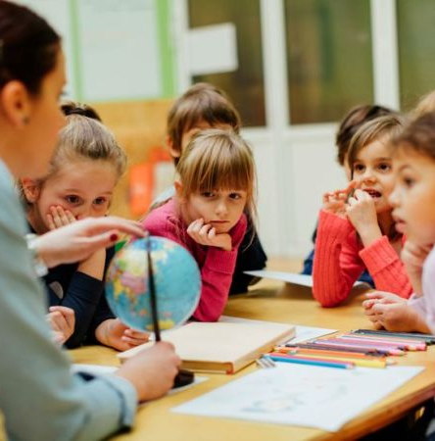
Visual Storytelling with DALL-E AI
Transformative Educational Tool
DALL-E AI revolutionizes visual storytelling in K-12 education by enabling students to create personalized images that enhance narrative comprehension, foster creativity, and facilitate deeper engagement with diverse subject matter through visual representation.

Slide 17
References
OpenAI. (2025). February 16 Version [Large language model]. ChatGPT. https://openai.com/chatgpt
OpenAI. (2025). A futuristic classroom with students learning interactively [AI-generated image]. DALL·E. https://openai.com/dall-e

